Slide 1
OVM – ONLINE VOTING MACHINE

Slide 2
INTRODUCTION
Online voting (also known as e-voting) is voting that uses electronic means to either aid or take care of casting votes.
Depending on the particular implementation, e-voting may use standalone electronic voting machines (also called OVM) or computers connected to the Internet. It may encompass a range of Internet services, from basic transmission of tabulated results to full-function online voting through common connectable household devices. The degree of automation may be limited to marking a paper ballot, or may be a comprehensive system of vote input, vote recording, data encryption and transmission to servers, and consolidation and tabulation of election results

Slide 3
HARDWARE REQUIRMENT
Microsoft Windows XP Professional SP3/Vista SP1/Windows 7 Professional:
Processor: Intel Core i5 or equivalent
Memory: 2 GB (32-bit), 4 GB (64-bit)
Disk space: 1.5 GB of free disk space

Slide 4
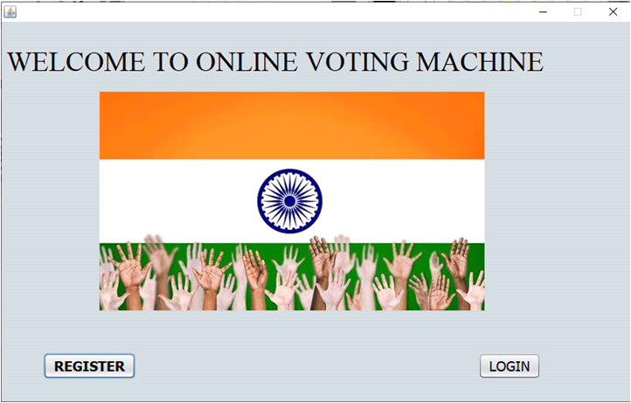
MAIN PAGE

Slide 5
This is the starting page of our project. It is the software used for voting while sitting at home. Here we have two buttons which are register and login respectively. Register will take us to registration page where we can put our personal details such as phone number, aadhar number e.t.c and login button is for the registered users who can login in with their personal details and vote.

Slide 6
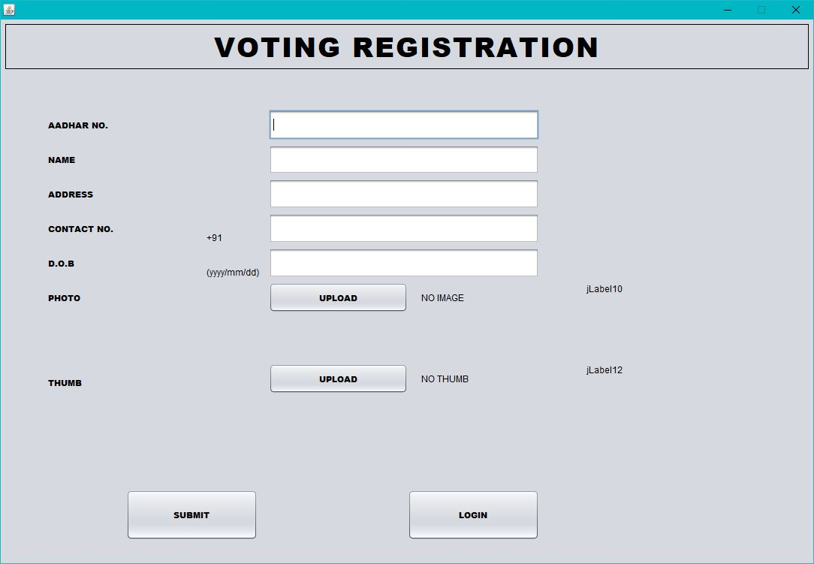
REGISTRATION PAGE

Slide 7
This is the registration page here new users can register for voting using their personal details such as Address, phone number and other. Here we have one photo section and thumb section so that we can know the user better. After entering all the details either user can submit or directly go on login page for voting.

Slide 8
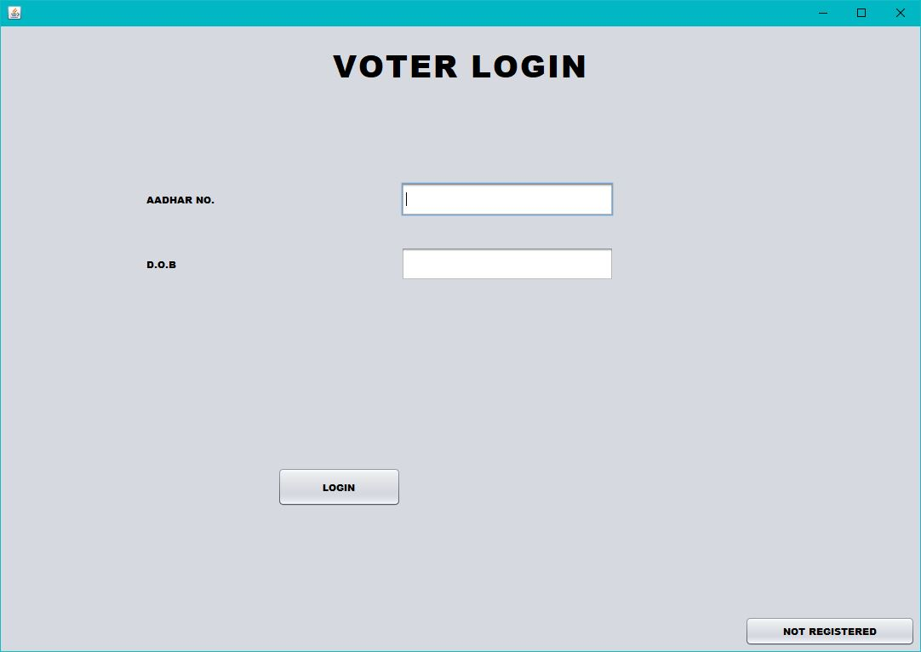
LOGIN PAGE

Slide 9
This is the login page. Here registered users can login using their aadhar number and date of birth and vote. If someone hasn’t registered yet can click on not registered and go to the registration page again.

Slide 10
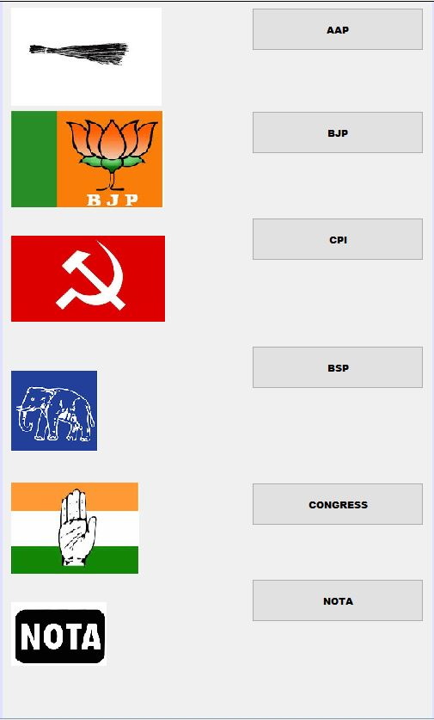
VOTING SCREEN

Slide 11
This is the final page. Here the user can vote for their favourite party and the record will be submitted in sql and only the admin can see

Slide 12
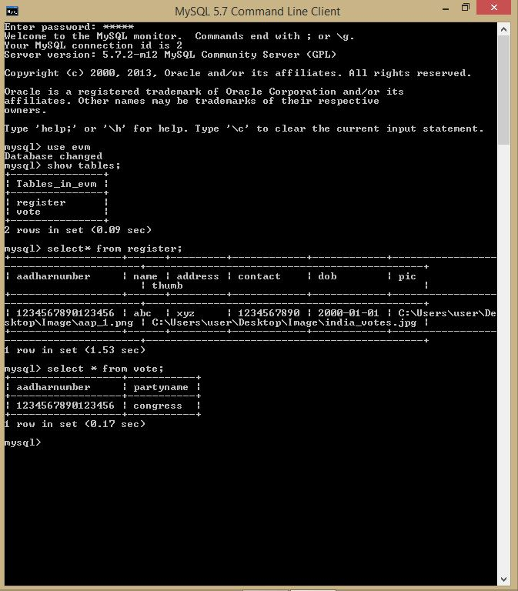
DATABASE CONNECTIVITY

Slide 13
This is the back-end of our project i. e database. Here we have two tables naming register and vote. Register is associated with registration page and vote is associated with the last page where the admin can see for whom have the people voted for.

Slide 14
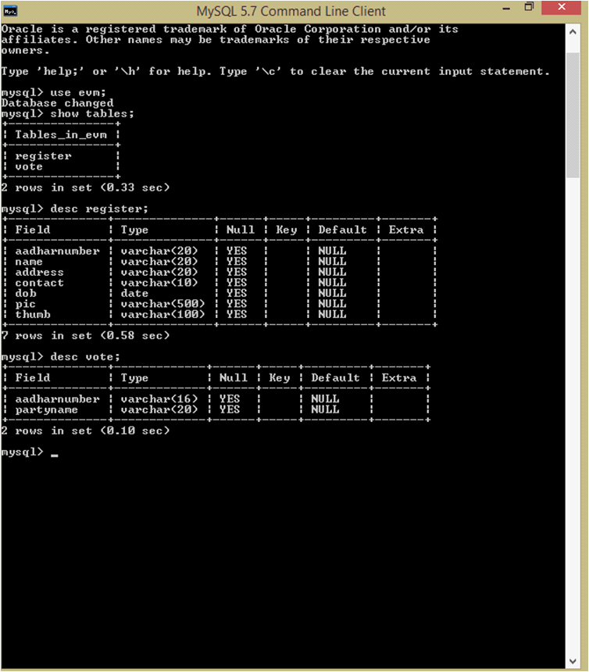
TABLES DESCRIPTION

Slide 15
Here both of those tables have been described in detail.

Slide 16
ADVANTAGES
It makes the process of counting of votes much faster than the conventional system.
Time conscious, less time required for voting.
It is Economical.
Avoids invalid voting.
Reduces transportation costs.
Conveninent on the part of voter.

Slide 17
DISADVANTAGES
Security issue.
Unequal internet access.
Have to provide continuous power supply.
Needs an stable internet connection.

